Slide 1
What to say and not say during a time of school crisis/major incident?
A Primer to Crisis Communication with your Local Media
Presented by Carolyn Donaldson,
WPSU Community Engagement Manager
REGION 6 ACT SAFE SCHOOLS SYMPOSIUM October 27, 2017

Slide 2




Slide 3
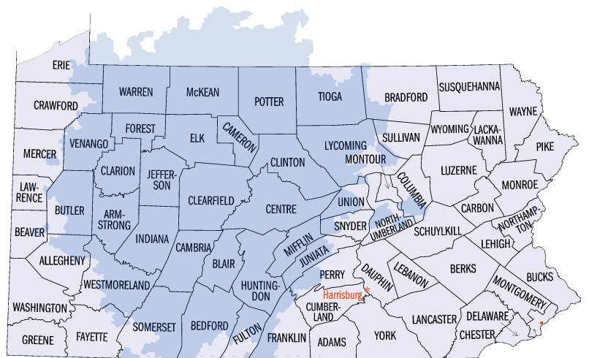
Television and Radio Reach
Television 24 counties
Four Digital Channels
WPSU-TV
WPSU Create
WPSU World
WPSU Kids
Radio 13 counties
Three Digital Channels
WPSU-FM NPR, Entertainment
WPSU-FM 2 NPR, Classical
WPSU-FM 3 Jazz
WPSU.ORG
Averages 320,000 Users/Year
1.9 Million People
Notes:
The WPSU-TV transmitter is located 7 miles north of Clearfield.
WPSU-TV’s strong over the air signal reaches northern Pennsylvania and Southern New York and down into the Bedford. Our primary designated marketing area is the Johnstown/Altoona/State College market, but we also overlap air space with Wilkes/Barre Scranton, Erie, and the Pittsburgh markets.
It is one of the largest rural markets in the PBS system. For about four percent, or approximately 20,000 households, WPSU is the ONLY channel they receive over the air.
Through the 2010 Pennsylvania Broadband Initiative, 96% of WPSU viewing households receive our signal through cable or satellite.
WPSU-FM, which began as a local student-operated radio station in 1953, has evolved into central Pennsylvania’s only full-service National Public Radio affiliate.
WPSU-FM serves more than 450,000 listeners in 13 central counties.
FM’s city of license is Kane, PA and it expands the signal through six translators in Altoona, DuBois, Treasure Lake, Clearfield, Huntingdon, and Bradford PA.

Slide 4
Simple Assumption
It’s not a matter of if your school will experience a crisis, it’s a matter of when. Thanks to smartphones, the Internet, and social media, the news cycle is now 24/7/365. Being prepared to communicate and respond during a crisis is more critical than ever.
Notes:
A crisis (from the Greek κρίσις - krisis;^{[1]} plural: "crises"; adjectival form: "critical") is any event that is either going or is expected to lead to an unstable and dangerous situation affecting an individual, group, community, or whole society. Crises are deemed to be negative changes in the security, economic, political, societal, or environmental affairs, especially when they occur abruptly, with little or no warning. More loosely, it is a term meaning "a testing time" or an "emergency event".

Slide 5
Two Styles of Media Reporting
Chronicle Reporting – Involves stories about the school play, school lunches, awards, retirements, special assemblies and programs, and board meetings (generally.)

Slide 6
Two Styles of Media Reporting
Event Reporting – Reporting style shifts into something less congenial when a crisis occurs.
For event or crisis report, timelines change, focus is different and competition among various media organizations heats up.

Slide 7
Responsibility During Crisis
The fundamental responsibility of a school administrator (Superintendent,etc.) in relating to the media when a crisis hits is to clearly outline the district’s response to help bring semblance, order, and direction to an event that could otherwise degenerate into chaos.

Slide 8
Responsibility During Crisis
To accomplish this, it is important to implement a thoughtful crisis communication plan including:
Internal Communication – Parents/Students, Employees, Board, Neighbors, Public – through website and Social Media

Slide 9
Responsibility During Crisis
To accomplish this, it is important to implement a thoughtful crisis communication plan including:
External Communication – working through the professional media – depending on scope – local, regional, national

Slide 10
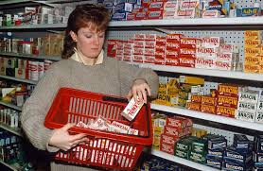
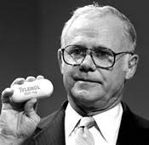
Tylenol Scare of 1982 – Crisis Communications Model
Notes:
http://www.ou.edu/deptcomm/dodjcc/groups/02C2/Johnson%20&%20Johnson.htm
Communication Theories
Methods
Analysis
Denny's
Challenger
Jack in the Box
Tylenol
Union Carbide
Discussion
Reference List
Team Members
Analysis
Case Study: The Johnson & Johnson Tylenol Crisis
Before the crisis, Tylenol was the most successful over-the-counter product in the United States with over one hundred million users. Tylenol was responsible for 19 percent of Johnson & Johnson's corporate profits during the first 3 quarters of 1982. Tylenol accounted for 13 percent of Johnson & Johnson's year-to-year sales growth and 33 percent of the company's year-to-year profit growth. Tylenol was the absolute leader in the painkiller field accounting for a 37 percent market share, outselling the next four leading painkillers combined, including Anacin, Bayer, Bufferin, and Excedrin. Had Tylenol been a corporate entity unto itself, profits would have placed it in the top half of the Fortune 500 (Berge, 1998).
During the fall of 1982, for reasons not known, a malevolent person or persons, presumably unknown, replaced Tylenol Extra-Strength capsules with cyanide-laced capsules, resealed the packages, and deposited them on the shelves of at least a half-dozen or so pharmacies, and food stores in the Chicago area. The poison capsules were purchased, and seven unsuspecting people died a horrible death.
The team's strategy guidance from Burke was first, "How do we protect the people?" and second "How do we save this product?" The company's first actions were to immediately alerted consumers across the nation, via the media, not to consume any type of Tylenol product. They told consumers not to resume using the product until the extent of the tampering could be determined. Johnson & Johnson, along with stopping the production and advertising of Tylenol, withdraw all Tylenol capsules from the store shelves in Chicago and the surrounding area. After finding 2 more contaminated bottles Tylenol realized the vulnerability of the product and ordered a national withdraw of every capsule
Johnson & Johnson's failure to employ/establish a positive relationship with the media, a key stakeholder, forced the company to respond to the crisis in an advertising-like manner. Johnson & Johnson received criticism from the media for not being genuine due to the slick sales-like response ads run during the crisis. The personal messages with the media from the CEO of the organization enabled Johnson & Johnson to overcome this problem.
Today Johnson & Johnson has completely recovered its market share lost during the crisis. The organization was able to reestablish the Tylenol brand name as one to the must trusted over-the-counter consumer products in American. Johnson & Johnson's handing of the Tylenol crisis is clearly the example other companies should follow if the find themselves on the brink of losing everything.

Slide 11
The Administrator and the Media Following Crisis
Be clear and factual. Reporters want to know the basics- who, what, when, where, why – and it’s important to provide as many facts as you know.
    Try not to guess, speculate, or inject your opinion even if asked to do so.
    If you don’t know the answer to a question, say that you don’t know the answer but will get information, if possible. Then follow up with the reporter.
      “We’re not certain…”
      “We believe what occurred was…”
      “The best information we have at this time is…” are all acceptable as long as what is stated as fact can stand scrutiny.

Slide 12
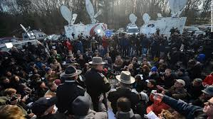
The Administrator and the Media Following Crisis
2. Be timely. Inquire about a reporters’ deadlines and try to help honor the deadlines by providing as much solid information as quickly as possible.
Notes:
The First 30 Minutes
What is done in the first 30 minutes of a crisis is crucial in determining people’s perceptions of the crisis and how it was handled.
Have the appropriate person handle the situation. An administrator (the principal or an assistant/designee) should take charge of the situation, implementing the crisis plan.
Understand the circumstances; define the problems.
Consider the options; act decisively to ensure the health and safety of students and staff and protection of district property.
Communicate with staff; keep the news media informed.
Update students periodically in their classrooms. Avoid having large group meetings.
Send the central office a crisis assessment and information sheet that includes the following:
Brief description of crisis.
Actions completed.
What you project will happen in the next two hours.
What resources you need.
Inform parents by letter, sent home with students at the end of the day, explaining what occurred and what has been done about it. If appropriate, e-mail could also be used to inform parents quickly.
Keep the community informed. To allay fears and demonstrate competence in handling the situation, get accurate information out through the news media and other methods such as your key communicators group.
Source: NSPRA’s Complete Crisis Communication Management Manual for Schools (2nd Edition). (March 2004 PRincipal Communicator)

Slide 13
The Administrator and the Media Following Crisis
3. Be a good resource. Provide the names and contact information for other reliable, potential sources that can provide additional information or insights or explain technical information. These other sources may include emergency responders, board members, teachers or union representatives and contractors.

Slide 14
The Administrator and the Media Following Crisis
4. Demonstrate that district administration is in control. What is said is important, but also who says it is also important.
The spokesperson (Superintendent/PIO) will convene news conferences and will be the primary contact person for the media as it relates to the school/district situation.
The spokesperson can call on other representatives to speak, but district administration is in charge and that message should be reinforced.
This strategy communicates that there is structure and is under control by a trusted and responsive institution.

Slide 15
Guidelines for Media Responses
Description of Crisis
  Extent of involvement.
  Do not release names of suspects.
  Refer questions to law enforcement.
  Hint: Avoid conjecture. State only facts.

Slide 16
Guidelines for Media Responses
Condition of Students/Staff
  Hint: Express concern for and empathy with victims.
  Hint: Speak from the viewpoint of public interest, not district’s interest.
  Hint: Avoid jargon/acronyms - eg. LEP students, Special Needs, etc.

Slide 17
Guidelines for Media Responses
Number injured/killed
  Potentially affected number.
  Nature of injuries.
  Care given to injured.
  Disposition of injured/fatalities.
  Example: “Staff members have accompanied injured students to ______ hospital(s) until family members arrived.”

Slide 18
Guidelines for Media Responses
Name of person(s) injured/killed
  Do not release.
  Refer to law enforcement and coroner. They release all information regarding this.
  Hint: “Next of kin are being notified first.”

Slide 19
Guidelines for Media Responses
Property Damage
  Estimated value.
  Hint: Avoid conjecture. Figures used by media may become Public Record.
  Example: “There has been considerable damage. We are in the process of assessing the extent of loss.”
  Description of damage
  Importance

Slide 20
Guidelines for Media Responses
Causes
  How discovered.
  Chronology.
  Were any measures taken to avoid/eliminate/minimize the disaster?
  Example: Refer to Emergency Services/Crisis Plan as to actions followed.

Slide 21
Guidelines for Media Responses
Rescue and Relief
  What is being done.
  Example: Refer to Crisis/Emergency Response Team.
  Personnel engaged in operation.
  How people/property were saved.

Slide 22
Guidelines for Media Responses
People’s Reactions
  How are students/staff/parents reacting?
  Example: ”Children/Students are safe; the situation is under control. School will remain open.”
  Or: “Children/Students have been safely evacuated to ___________ where parents or persons listed on their child’s emergency card may pick them up.”

Slide 23
Guidelines for Media Responses
What help is available?
  Example: Crisis/Emergency Response Team are assisting students and staff.

Slide 24
Scenario 1
There has been a school bus accident (BUS #12) involving 35 students on the way to school.
Driver of a car missed a stop sign and collided with side of bus.
Unknown injuries at this time.
Know of several transports via ambulance to hospital.
http://news3lv.com/news/local/bus-crash-news-conference
Notes:
http://news3lv.com/news/local/bus-crash-news-conference

Slide 25
Scenario 2
Reported Bullying incident on middle school grounds at the close of the school day - hit virally over Social Media – Video.
Conflict between 2 students and 1 non-student (adult).
School Resource officer not on any video shown, but rumored to have been nearby as “incident was going down”.
http://www.nj.com/morris/index.ssf/2017/08/school_district_we_tried_to_stop_bullying_of_mallo.html
Notes:
http://www.nj.com/morris/index.ssf/2017/08/school_district_we_tried_to_stop_bullying_of_mallo.html

Slide 26
Scenario 3
Lockdown at all school sites near the SCI facility within 10 miles.
Reports coming out of Social Media and confirmed by police and onsite.
Media convening at police command post where all traffic has been stopped.
Time of Day – 2:15pm

Slide 27
Scenario 4
Reports of ”weapon” carried into school by high school student.
Previous “supposed threats” on social media posts of potential violence at school.
Media received numerous calls from concerned parents about what is happening.
Media converging on school building. Barrage of calls coming into school/district office.

Slide 28
Scenario 5
Natural Disaster in the form of rising waters in River/Creek bed behind elementary school due to heavy and continued rainfall.
Area roads surrounding school are also becoming flooded.
Mid-day – School dismissal at 2:30pm
Parents calling into TV stations and stopping reporter covering flooding to alert them of school situation.
Media heading to scene of flooding - TV, etc.

Slide 29
Carolyn Donaldson,
Community Engagement Manager cdonaldson@psu.edu
THANK YOU!

